Slide 1
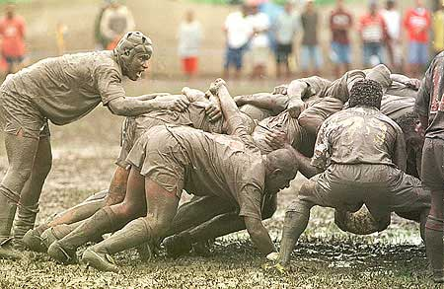

Waterfall/Scrum
Combining – A scrum with water…
You might want to take notes, because specific aspects of the processes will be on the exam.
Notes:
Pictured is the savage Scrum of the game Rugby, from which the Scrum agile software development process gets its name. From http://www.coretrek.no/scrum-i-et-noetteskall/category642.html.

Slide 2
Week two’s plan
Project/presentation feedback from each person
Learn 4 specific processes one after the other
  Do an activity about each one!
  A bit of management/leadership theory on each one
  Your questions from each of the reading quizzes
Talk about them in class Friday (today)
Before next week’s class:
Do a take-home exam on them
  Due next Thursday night
Goal – You know these well enough to discuss with other people in the software business!
← First
→

Slide 3
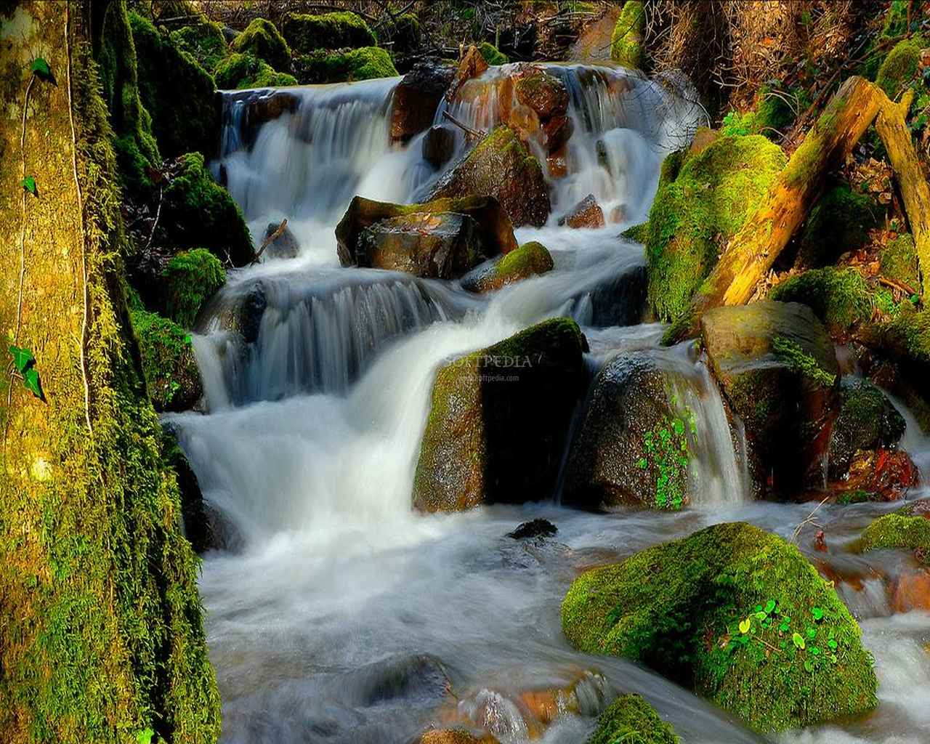
What is the waterfall process?
Ask / Analyze what to do
Figure out a plan to do it
What are the stages?
Make the pieces, to plan
Put them together, test
Ship it /
install it
Support / maintain it
→
Notes:
Staged waterfall image is from http://hdiphone-wallpapers.blogspot.com/2010/06/waterfalls-wallpapers-scenery.html.

Slide 4
Stages – in the Tech Republic Article
Based mostly on:
Requirements analysis
Design
Implementation
Testing (integration)
Installation
Maintenance
Each of these stages ends in a “milestone” – with the creation of some artifact representing the results of that work.
This is “CM” in action, in Phillips’ terminology.
What issues does this limited view cause?
→

Slide 5
Work in your groups to generate lists
Pros: advantages of the waterfall process
Cons: disadvantages of the waterfall process
Finally:
  Under what circumstances (given the pros and cons above) would waterfall be a potential process you would want to use?
Then we’ll all discuss!
→

Slide 6
How did your team decide?
Were there leaders and followers?
Was there a consensus?
Would there have been a problem in doing it this way, if you were part of a “waterfall” process?

Slide 7
Slight tangent on management theory
Waterfall fit in well with ideas from the 1980’s and earlier, about what a leader “is”:
  Leadership is “getting followers to do what the leader wants done.”
  Leadership is (non-coercive) influence
  Leaders are assumed to have special “traits”
  Leaders and followers engage together in a “transformation” involving motivation and morality.
Notes:
From Peter G. Northouse, Leadership Theory and Practice, 7th ed, 2016 !

Slide 8
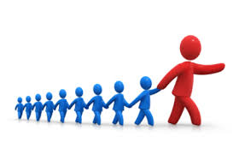
How’s that fit with waterfall, exactly?
Good ideas flow down the waterfall.
They are associated with having the right people giving directions to others, at each stage.
The leaders also work to convince others to do the right thing.
E.g., designers “selling”
their new design ideas
to implementers.
Or, the “CM team” signs-
off on project artifacts at
each “milestone.”
Notes:
Image from http://tpsconsultingltd.com/2015/01/26/leadership-practice-reflections-leadership-part-one-two/.

Slide 9
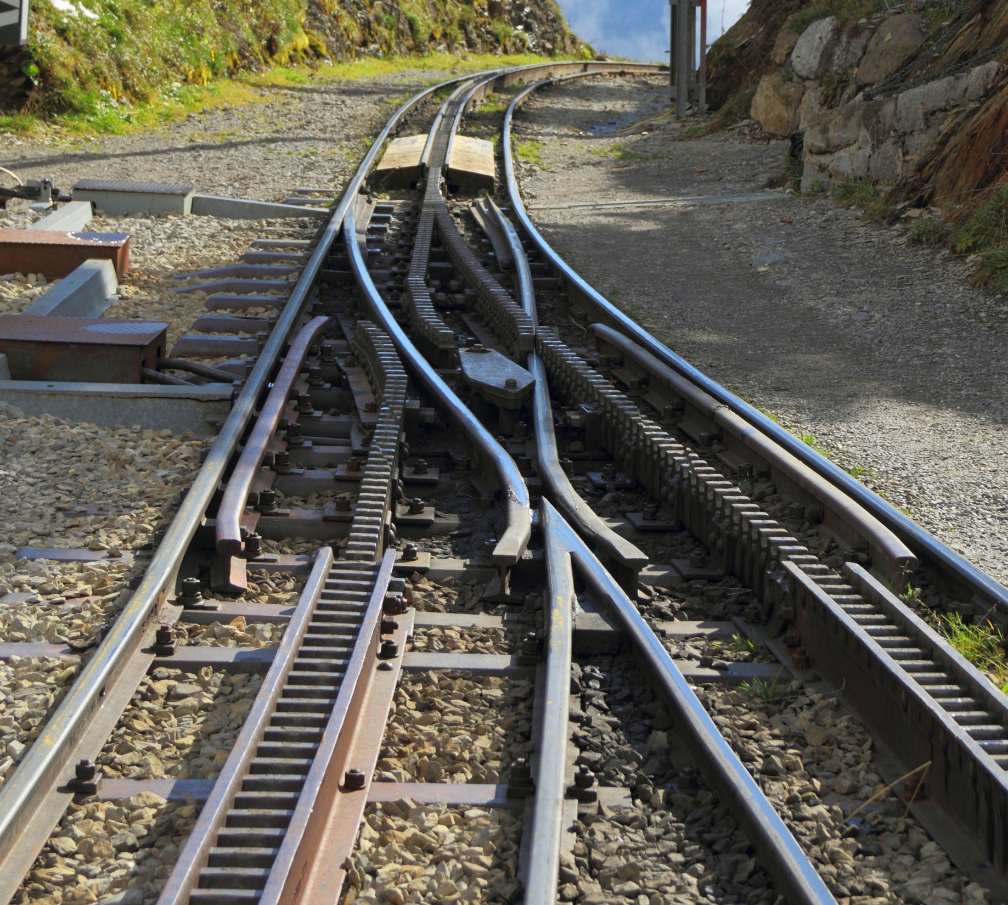
What is the product backlog?
How are things formulated? Why?
Who prioritizes?
Who estimates?
Switching gears…
Scrum!
→
Notes:
Geared railway turnout image from http://en.wikipedia.org/wiki/Railroad_switch.

Slide 10
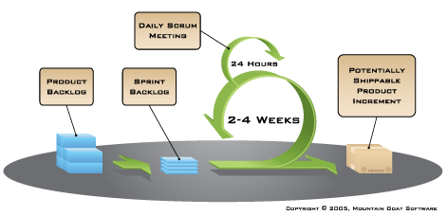
Lots of cycles
Look like this:
Notes:
Image from http://www.mountaingoatsoftware.com/agile/scrum/overview.

Slide 11
Activity – inventing user stories
This is what the product owner does.
  Except that they need help with doing it well.
  More often, they narrate, and we create these as they talk, asking for confirmation.
  Converts “features” to an actionable form:
    As a <type of user>, I want <some goal> so that <some reason>.
Notes:
Template from http://www.mountaingoatsoftware.com/agile/user-stories.

Slide 12
Let’s try an example, in your groups
Product owner’s narrative:
“Users need to be able to back up all their data. This includes power users who know exactly what needs to be backed-up, and novices who don’t know and won’t do it. For both, the process must be as automatic as possible.”
On your team, make this into one or more user stories, as appropriate.
    As a <type of user>, I want <some goal> so that <some reason>.

Slide 13

How did your team decide?
Were there leaders and followers?
Was there a consensus?
Would there have been a problem in doing it this way, if you were part of an agile, “self-organizing” team?
  We’l discuss this
  concept more today
Notes:
Image from http://advantureconsulting.com/blog/leadership/team-consensus/attachment/team-consensus/

Slide 14
The Sprint Planning Meeting
Before this – the team estimates features (user stories)
  This rationalizes, and it unifies the team
  See the trick called Planning Poker
During – Can have fights with product owner
  What are their common interests?
  What are their opposing interests!
Sprint backlog results
Eight hour time limit
“Once a Sprint's Product Backlog is committed, no additional functionality can be added to the Sprint except by the team. ”

Slide 15
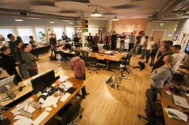
Day to day life in Scrum
“Daily Scrum” - 15 minute stand-up meetings
Work on code in the sprint backlog
What is missing
from this picture?
Notes:
Image of standup meeting from http://online.wsj.com/news/articles/SB10001424052970204652904577193460472598378.

Slide 16
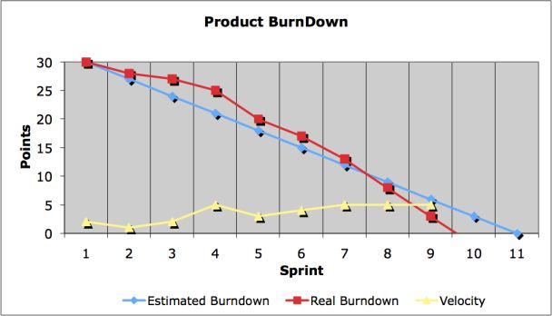
Reflecting – integral to Scrum
Sprint/Release burn down
Sprint Review
  Show product owner what now works
Sprint Retrospective
  How well is Scrum
  working?
What is missing again?
Notes:
Burn down chart image from http://www.scrum-institute.org/Burndown_Chart.php.

Slide 17
Question for Scrumsters?
What is the biggest assumption made here?
What is the biggest risk likely to be?

Slide 18
Second tangent on management theory
Agile fits in well with 21st Century ideas of leadership.
A team can still have leaders, but they arise from and remain part of the team by virtue of:
  Authentic leadership
  Visionary leadership
  Servant leadership
  Adaptive leadership
And there is recognition that everyone has “a time to lead and a time to follow.”
See notes, below, for more.
→
Notes:
Authentic leadership – Feels real to followers, like “being one of them” and understanding them and the situations they all face.
Visionary leadership – values, sense of calling and membership to motivate followers.
Servant leadership – leader uses “caring principles” to focus on followers’ needs, help them become more autonomous.
Adaptive leadership – leaders encourage followers to confront and solve problems.
From Peter G. Northouse, Leadership Theory and Practice, 7th ed, 2016

Slide 19
How’s that fit with Scrum, exactly?
The team relies on itself.
  Expertise and leadership both exist in the team.
  Leadership roles move around, depending on the situation.
  Everyone has an area where they provide guidance.
    There is an expectation of developing this.

Slide 20
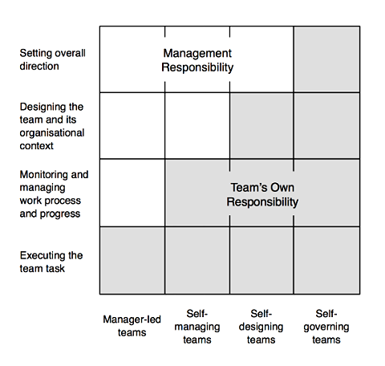
The dynamics with a larger organization can be fluid!
Where’s the boundary of the team’s responsibility?
Notes:
Image from http://www.infoq.com/articles/what-are-self-organising-teams.

Slide 21
We’ll build on this start
Like, how do you do all the planning steps in more detail – next week.
  Say, burn-up / burn-down
Or, how to do the estimating – week 4.
Or, risk planning – week 5.

Slide 22
Your questions from the reading quiz
My pick
Your choice

